Slide 1

Higher Education and the Future DevOps Workforce
Macro and micro

Slide 2




Charlie Betz
CharlesTBetz
char@dm-academy.com
www.lean4it.com
Notes:
Charlie Betz, very pleased to be here. If you want to find out more about me, I’m easy enough to find, so let’s get into the presentation.
Not a full time academic (teach *one* course as an adjunct) -Writing an MIS/IT survey textbook, with Agile and DevOps as foundation -

Slide 3

What?
The importance of Higher Education
Current challenges in educating the digital workforce
How computing curricula are defined
The Digital Curricula report
A modern digital course

Slide 4
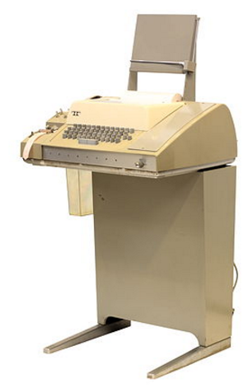
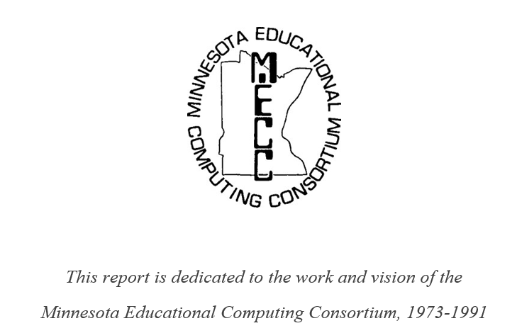
Acknowledging MECC
Notes:
Anybody play Oregon Trail? This report is dedicated to the Minnesota Educational Computing Consortium, that did things like put model 33-ASR Teletypes in junior high science classrooms throughout the state. The first time I “died of dysentery” it was printed out on yellow continuous paper on a device like that in Mr. Stedman’s science classroom, which was also where I first learned to program in HP Time-shared Basic on an HP 2000.

Slide 5
Scale of the Education System
Total post secondary enrollment, fall ‘14 | 20,663,464
Higher education staff | 3,969,226
Annual expenditures | $520 billion
Market value of endowment funds | $539 billion
Physical plant | ~$500 billon
Annual U.S. GDP for comparison | $18.6 trillion
Notes:
No, traditional full-time public higher education is not going to fade away overnight in favor of MOOCs, distance education, coding boot camps or unschooling or what have you. Period. If lack of talent is a problem… It’s crazy to disregard a system of such scale and scope. Roughly a trillion in capital and half a trillion a year in operations.
http://nces.ed.gov/programs/digest/d15/tables/dt15_301.10.asp?current=yes
http://nces.ed.gov/programs/digest/d15/tables/dt15_301.20.asp?current=yes

Slide 6
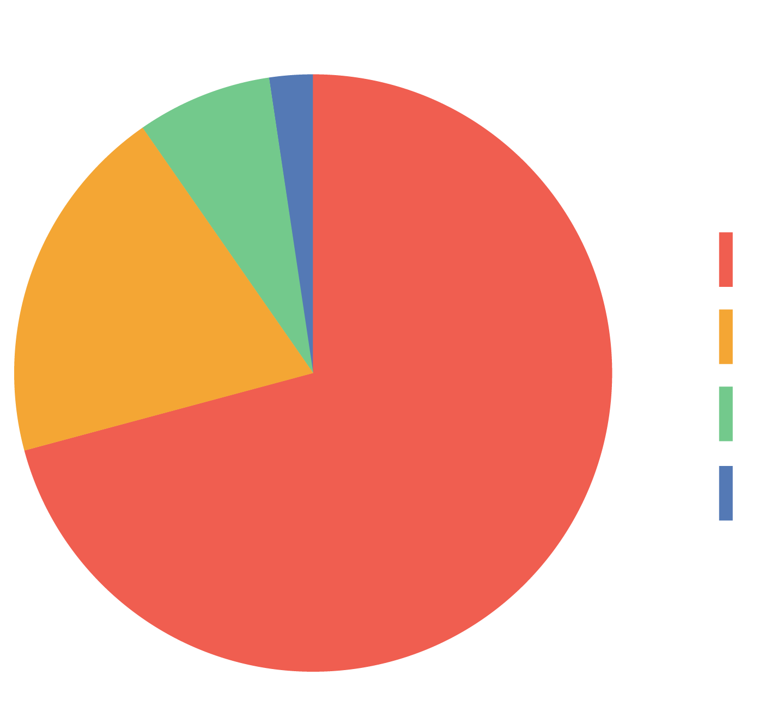
Higher Ed by Institution Type
2%
8%
Public
Private non-profit
Private for-profit
Non-degree
19%
71%
Notes:
People want to send their kids away for a few years to learn, it’s been a thing since the Middle Ages or before. Of that twenty million, where are they going? Universities have a long tradition of state support.

Slide 7


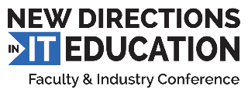
Minnesota State Colleges & Universities
30 colleges, 7 universities, 54 locations
400.000 students
$2 Billion annual budget
5th largest higher education provider in the US
Notes:
Yes, MN State is big. Advance-IT is the center of excellence that sponsored the report, New Directions is the annual educator/industry conference (Nicole was kind enough to come and keynote this spring, where we kicked this effort off)

Slide 8
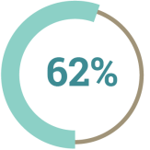
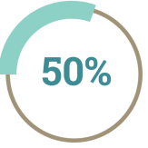
Workforce Survey
159 faculty and industry professionals, primarily US
Agile skills
62% consider as a factor, and
50% of those started doing so within the last 3 years
Notes:
159 industry and educational professionals responded, on topics such as Agile skills, DevOps, and workforce.

Slide 9
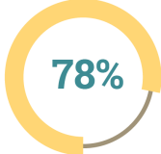
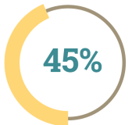
Workforce Survey
DevOps
78% of industry respondents view Continuous Delivery as either emerging or mainstream
45% of schools do not cover Continuous Delivery at all

Slide 10
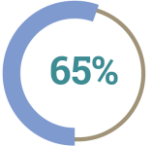
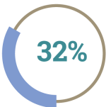
Workforce Survey
Workforce
65% of education professionals think education system is providing a well prepared digital workforce
32% of industry respondents agree

Slide 11
The View from Startup Community
“
There is almost twice as much demand for the product programmer… than there is for programmers focused on hard technical problems.
”
Ammon Bartram, Y-Combinator
Notes:
Now, in terms of *what* industry is looking for … what are the needs of the new digital workforce? For example, what is the nature of the programmers required? Y-Combinator, in a survey of “what startups need,” noticed that programmers with a strong product focus were far and away the most desired. Customer-focused, user experience focused, etc. Not technical programmers focused on algorithms – product programmers focused on usability, user experience, et almost twice as much in demand.

Slide 12


University of Minnesota
Carlson School of Management
Computer Science and Software Engineering
What could possibly go wrong?
Notes:
Where do we get these product-oriented programmers?
This is the University of MN. My wife and I have 5 degrees from here (she’s the smart one with the Ph.D. in geology). Notice the Carlson school, where we might find Product Marketing, about as far away as we can get from the CS department, with this big river thing in the middle. Consider Conway’s Law: organizations which design systems ... [tend to produce] copies of their communication structures... The U of MN is, in a sense, designing our workforce. What could possibly go wrong?
We’ll return to this question of how disciplinary boundaries are set

Slide 13

Version Control
Andrew Clay Shafer:
“the foundation of every other Agile technical practice” do not provide practical exposure
57%
Notes:
Pivot: what about specific practices? Another theme we certainly hear anecdotally is that “the students are coming out of school and they don’t even know version control.”
A majority of educators (57%) say their curriculum does not provide practical experience in version control
State of DevOps says it is one of the factors MOST correlated with digital delivery performance. And it’s not a trivial topic. There is both practical and principle to dig into from an academic perspective; the concept of VC as representing organizational “state” is compelling.
Ultimately I would compare to hygienic practices in healthcare. Interns and residents are expected to know how to sanitize, and WHY they do so. Practical expectation throughout the healthcare community, and yet grounded in important theory (germ theory of disease). Same thing w/ VC – as Andrew Clay Shafer suggests, it’s the foundational practice that supports the rest of Agile.

Slide 14
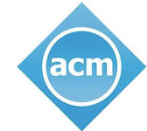

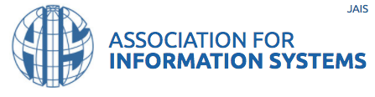
The Players
Notes:
So, why do we have the educational structures that we do? Because specific decisions were made and are being made by specific people at specific places and times, under the auspices of well known industry organizations that we all support at least through tax exemption. They have a social mandate. These are the major players: the IEEE, which handles the engineering side, the AIS, which handles the business school side, and the ACM which plays an overall umbrella & coordination role and is deliberately shown larger here. This nexus is largely responsible for how the computing-related disciplines are structured in the US at least. Other countries have different players: British Computer Society in the UK for example.

Slide 15
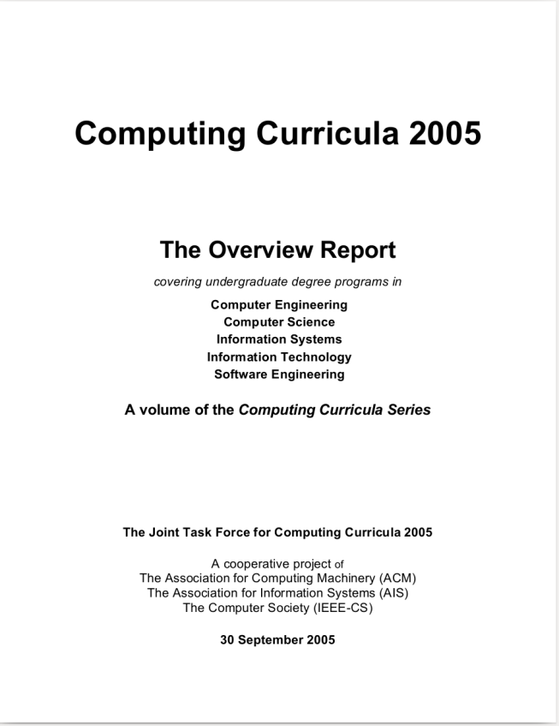
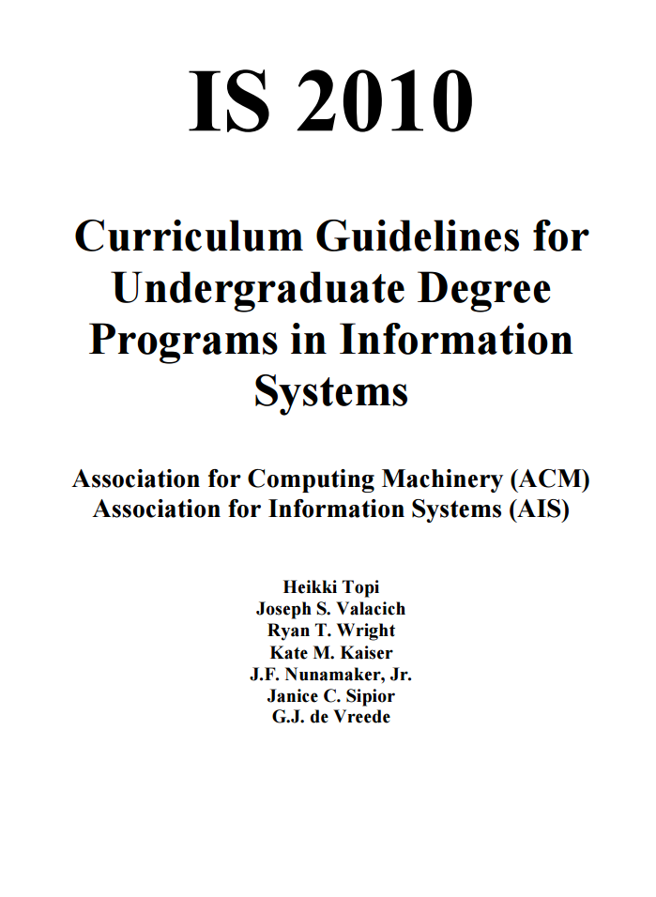
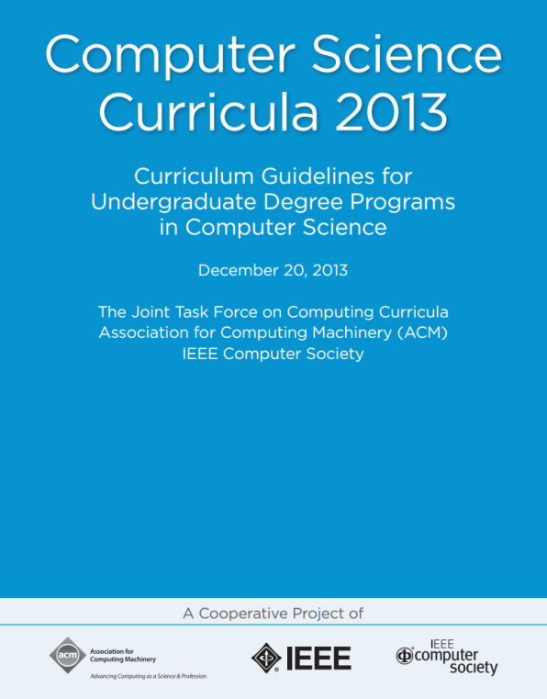
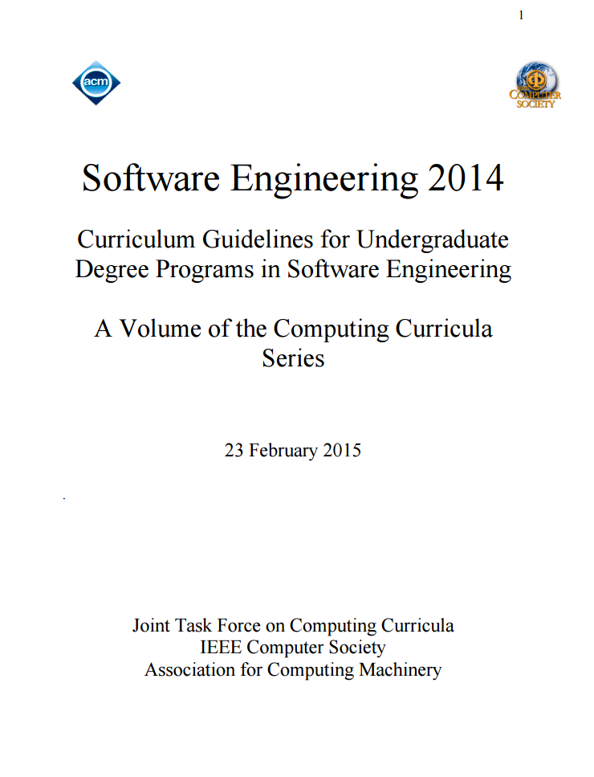
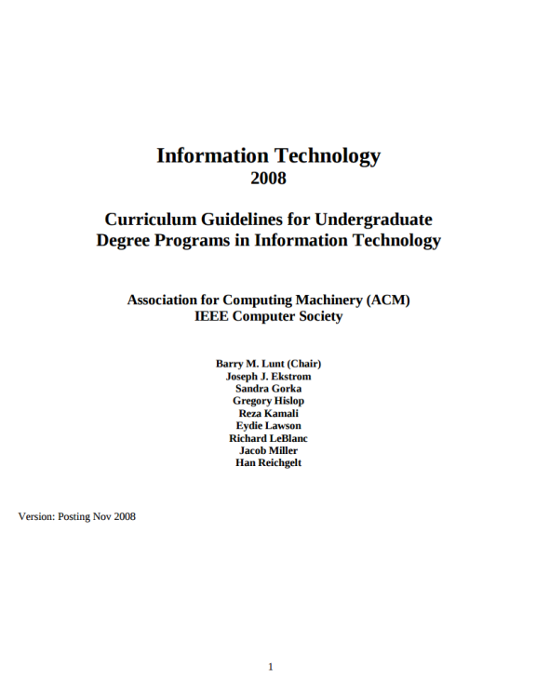
How Curricula are Defined
HTTP://WWW.ACM.ORG/EDUCATION/CURRICULA-RECOMMENDATIONS
Notes:
Why do we have the programs we do in the US? Because a group of academics, sponsored by ACM, IEEE and AIS got together in 2005 and decided that the degrees would be CE, CS, SE, IS, IT. As much as it might be denied, there’s a rough status ordering there, with CE at the top and IT at the bottom. There is some variation (MIS, CIS, etc) but in general these have held. B-schools get MIS, C-schools get CE/CS/SE, IT varies. And, once scoped, further working groups were established to define each discipline in detail, and those reports you see on the right here have been produced on a rolling basis for years. And if you dig into those reports you see very interesting assumptions, including for example very clear statements that CS majors need to know next to nothing about business matters including product management – even requirements management is . It’s all at that URL…

Slide 16
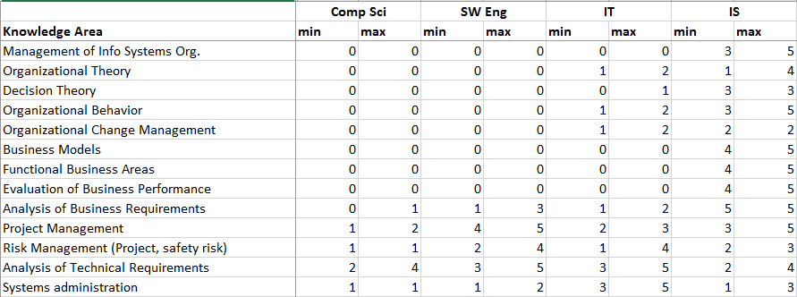
For example
Notes:
Some interesting scoping…
Lot of detail here, you can come back to this. It’s from the 2005 report that set the boundaries. Basically, you can read this as saying: MIS majors do business requirements, business models, business performance (including product mgmt, presumably) – and CSCI majors analyze tech requirements, and do techie stuff. See all the things that are “zeroed out” for them?
There’s a further wrinkle. I spoke recently with a senior CSCI professor at the U of MN, who observed that CS departments historically (especially at top tier schools) are incented to produce researchers. And yet, the CSCI degree is *also* increasingly viewed as the gold standard by hiring managers in industry. There’s at least anecdotal evidence that IS degrees simply aren’t well regarded by digital hiring mgrs, let alone IT degrees. I don’t have data but does anyone think the traditional MIS degree is rocking and rolling the digital industry? The disconnect is causing concern; industry wants higher volumes of computing grads (up to 50%-100% increases), with a different profile. So let’s look at what that profile might be.

Slide 17
Core vs. Contextual Courses
Core
Fundamentals of computation
Algorithms & data structures
Automata
Operating systems
Compilers & languages
Applied
Data management
Networking
Security
Distributed systems
User interaction (useful)
Contextual
Project management
Requirements management
Analysis & architecture
Software quality & process
Business context (MIS)
Missing
Product management (it’s over in Marketing. Sort of.)
Operational topics (full lifecycle & execution issues)
Organization and culture
Realistic experiential labs & simulations: full-lifecycle, full-stack
INFORMATICS?
Notes:
Core stuff on the left – we need it. Not talking about it today.
Stuff on the right is where we have the gaps. For example, a SW Eng or even CSCI program might offer 3 credits of Project Management when companies are shutting down PMOs in favor of going to continuous flow approaches?? Big “batches” of up front requirements and architecture design, baked into the curriculum in 3-credit chunks? What about product management? That’s the big gap. Operations? It’s been shunted off, at best, to the IT degree, and yet here you have SRE calling for CS majors in Ops… those CS grads are landing in orgs with heavy operational aspects, high-flow digital pipelines, and under current curricula they are simply going to be unprepared…
In Europe there’s an Informatics tradition… here at UC Irvine, Indiana, Northwestern… not sure, but perhaps it’s the way to go -

Slide 18
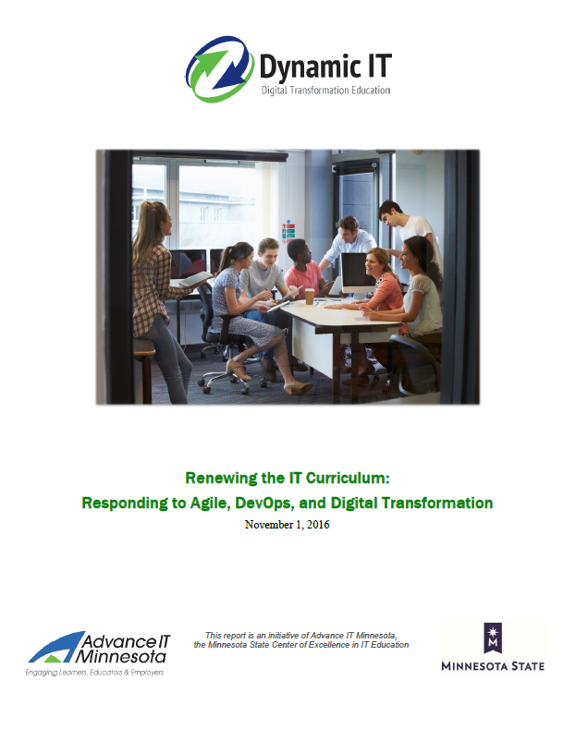
The Report
Agile/DevOps importance, definitions, background
Five Competency Areas
Dynamic infrastructure and operations
Continuous delivery
Product management
Resource and execution
Organization and culture
Recommendations for course adaptations
Digital labs and simulations
http://dynamicit.education
Notes:
So, turning to the report: this is how we structured it. First, we provide an overview of the Agile/DevOps/Digital context, and give people lots of references to think about. The historic failure of CMM and the emergence of empirical process control, for example, along with the origins of Agile, “10 deploys a day,” Cloud, SRE, product mgmt., culture, and more. Then we define five competency areas, that I think could be considered by ANY computing-related degree program. (We’ll talk about their definitions next). Finally, we make some specific recommendations for adapting and creating new courses, and conclude with some thoughts on digital labs and simulations.

Slide 19
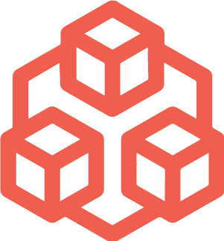
Dynamic Infrastructure and Operations
From physical, hand-configured infrastructure to virtual, software-defined infrastructure
Notes:
This is the first what we call “Competency Area.” It breaks down into competency categories and competencies, with many suggested learning objectives for course designers to consider as a reference. Virtualization, Cloud, infrastructure as code, and site reliability engineering; operational practices, and so on. Learning objectives for this one include references to John Allspaw, Tom Limoncelli, the recent Google SRE book edited by Betsy Beyer, and more.

Slide 20

Continuous Delivery
From “code complete” to “full lifecycle”; from batch handoffs to ongoing digital value production
Notes:
The full pipeline as a socio-technical system. Not DevOps; that includes culture and product management. This is more narrowly about the full pipeline and does scope in the Agile foundations in software development. LOs here of course relate to the core Agile and Scrum literature, by people like Martin Fowler, Alistair Cockburn, Mike Cohn and Ken Rubin, as well as continuous integration by Paul Duvall and continuous delivery by Jez Humble and of course the State of DevOps research by Forsgren et al

Slide 21

Product Management
From deliverable-focused project management to outcome-focused product management
Notes:
85,000 Scrum Product Owners – where do they come from? What should new ones learn in school? If I want to go into this as a field, what do I do? What do I need? It’s a huge gap. For faculty tangling with this tough new area, we suggest Marty Cagan, Steve Blank, Jeff Patton, Jeff Gothelf, and design thinking folks. We also note that existing UI/UE design courses might be a good base on which to build.

Slide 22

Resource and Execution
From execution models resulting in overburden, multitasking and poor IT delivery, to concern for value, flaw, and work in process
Notes:
We need a better language for discussing and analyzing. Things are too religious. “DevOps vs ITIL!” NOEstimates! NoProjects! “SAFE vs LESS!” Scrum vs Kanban! We need a more clinical terminology (got a blog in me about this) With h/t to Reinertsen: cadence, synchronization, batch size, queuing, specialization, skill vs. product alignment. We bring in Reinertsen big time here, as well as the more advanced Scrum thinking by folks like Craig Larman and Mike Cohn, and folks like Scott Ambler, David Anderson and Dean Leffingwell. We bring in the notable influences and some of the LOs suggest that people compare and contrast different points of view.

Slide 23

Organization and Culture
From inattention to culture, to recognition of culture´s central role in digital product delivery effectiveness
Notes:
Students need to be able to assess whether they are in a culture that supports high performance. Employers need to know if their companies have such a culture. We can quantify this.. The report calls out Google’s Project Aristotle, the State of DevOps work with the Westrum typology, and so forth.

Slide 24

“Vocationalism?”
Notes:
Now one of the things we often hear is that tech moves too fast… People especially at the research schools will say “We are not vocational” (This is why I’m less personally interested in the Tier 1 research institutions--actually, many institutions ARE vocational, this report is intended for 2-year tech & junior colleges as well as 4-year teaching colleges)…
This is not about “let’s teach the latest version of Jenkins.” What we are saying in this report is that there are fundamental, generational, tectonic changes in how we understand and deliver digital value. This is not mere “vocationalism” any more than expecting a medical resident to have a certain level of practical skill…
And to the research faculty in a strict publish/perish model – it’s true you play a different role, not as workforce-oriented
You think there are not meaningful, meaty questions emerging here? Site reliability and full lifecycle digital engineering practices? Intersection of industrial engineering & operations research with digital? Human factors? Intersection of digital and culture? We could create hundreds of Ph.Ds with the topics discussed at this conference. There’s serious stuff going on here.

Slide 25
Pedagogy
Course updates
Requirements
QA
Arch
Usability/UI design
New courses
Product management
Operations
Culture & organization
Digital labs and simulations
Digital pipelines
Software-defined networking
Chaos engineering
Site reliability engineering
Notes:
So much for the LOs. Don’t have time to go into the whole report here.
As we look at pedagogy and course updates, a few things. It’s not easy to create net new courses, but the report suggests various ways in which existing courses might be renewed, e.g. by bringing continuous integration & delivery into SQA courses. But product management and operations may well call for new courses, hopefully with a heavy lab component so people can get practical. The report also goes into virtual labs and simulations -- virtualization and cloud are the instructor’s friend! You can provide realistic industrial experiences for a fraction of the cost 10 years ago. This is an area I’m interested in having further discussions in, with vendors and other academics wanting to partner. Let’s get a Chaos Engineering lab out there on Github in a form that front-line, busy faculty can use!

Slide 26
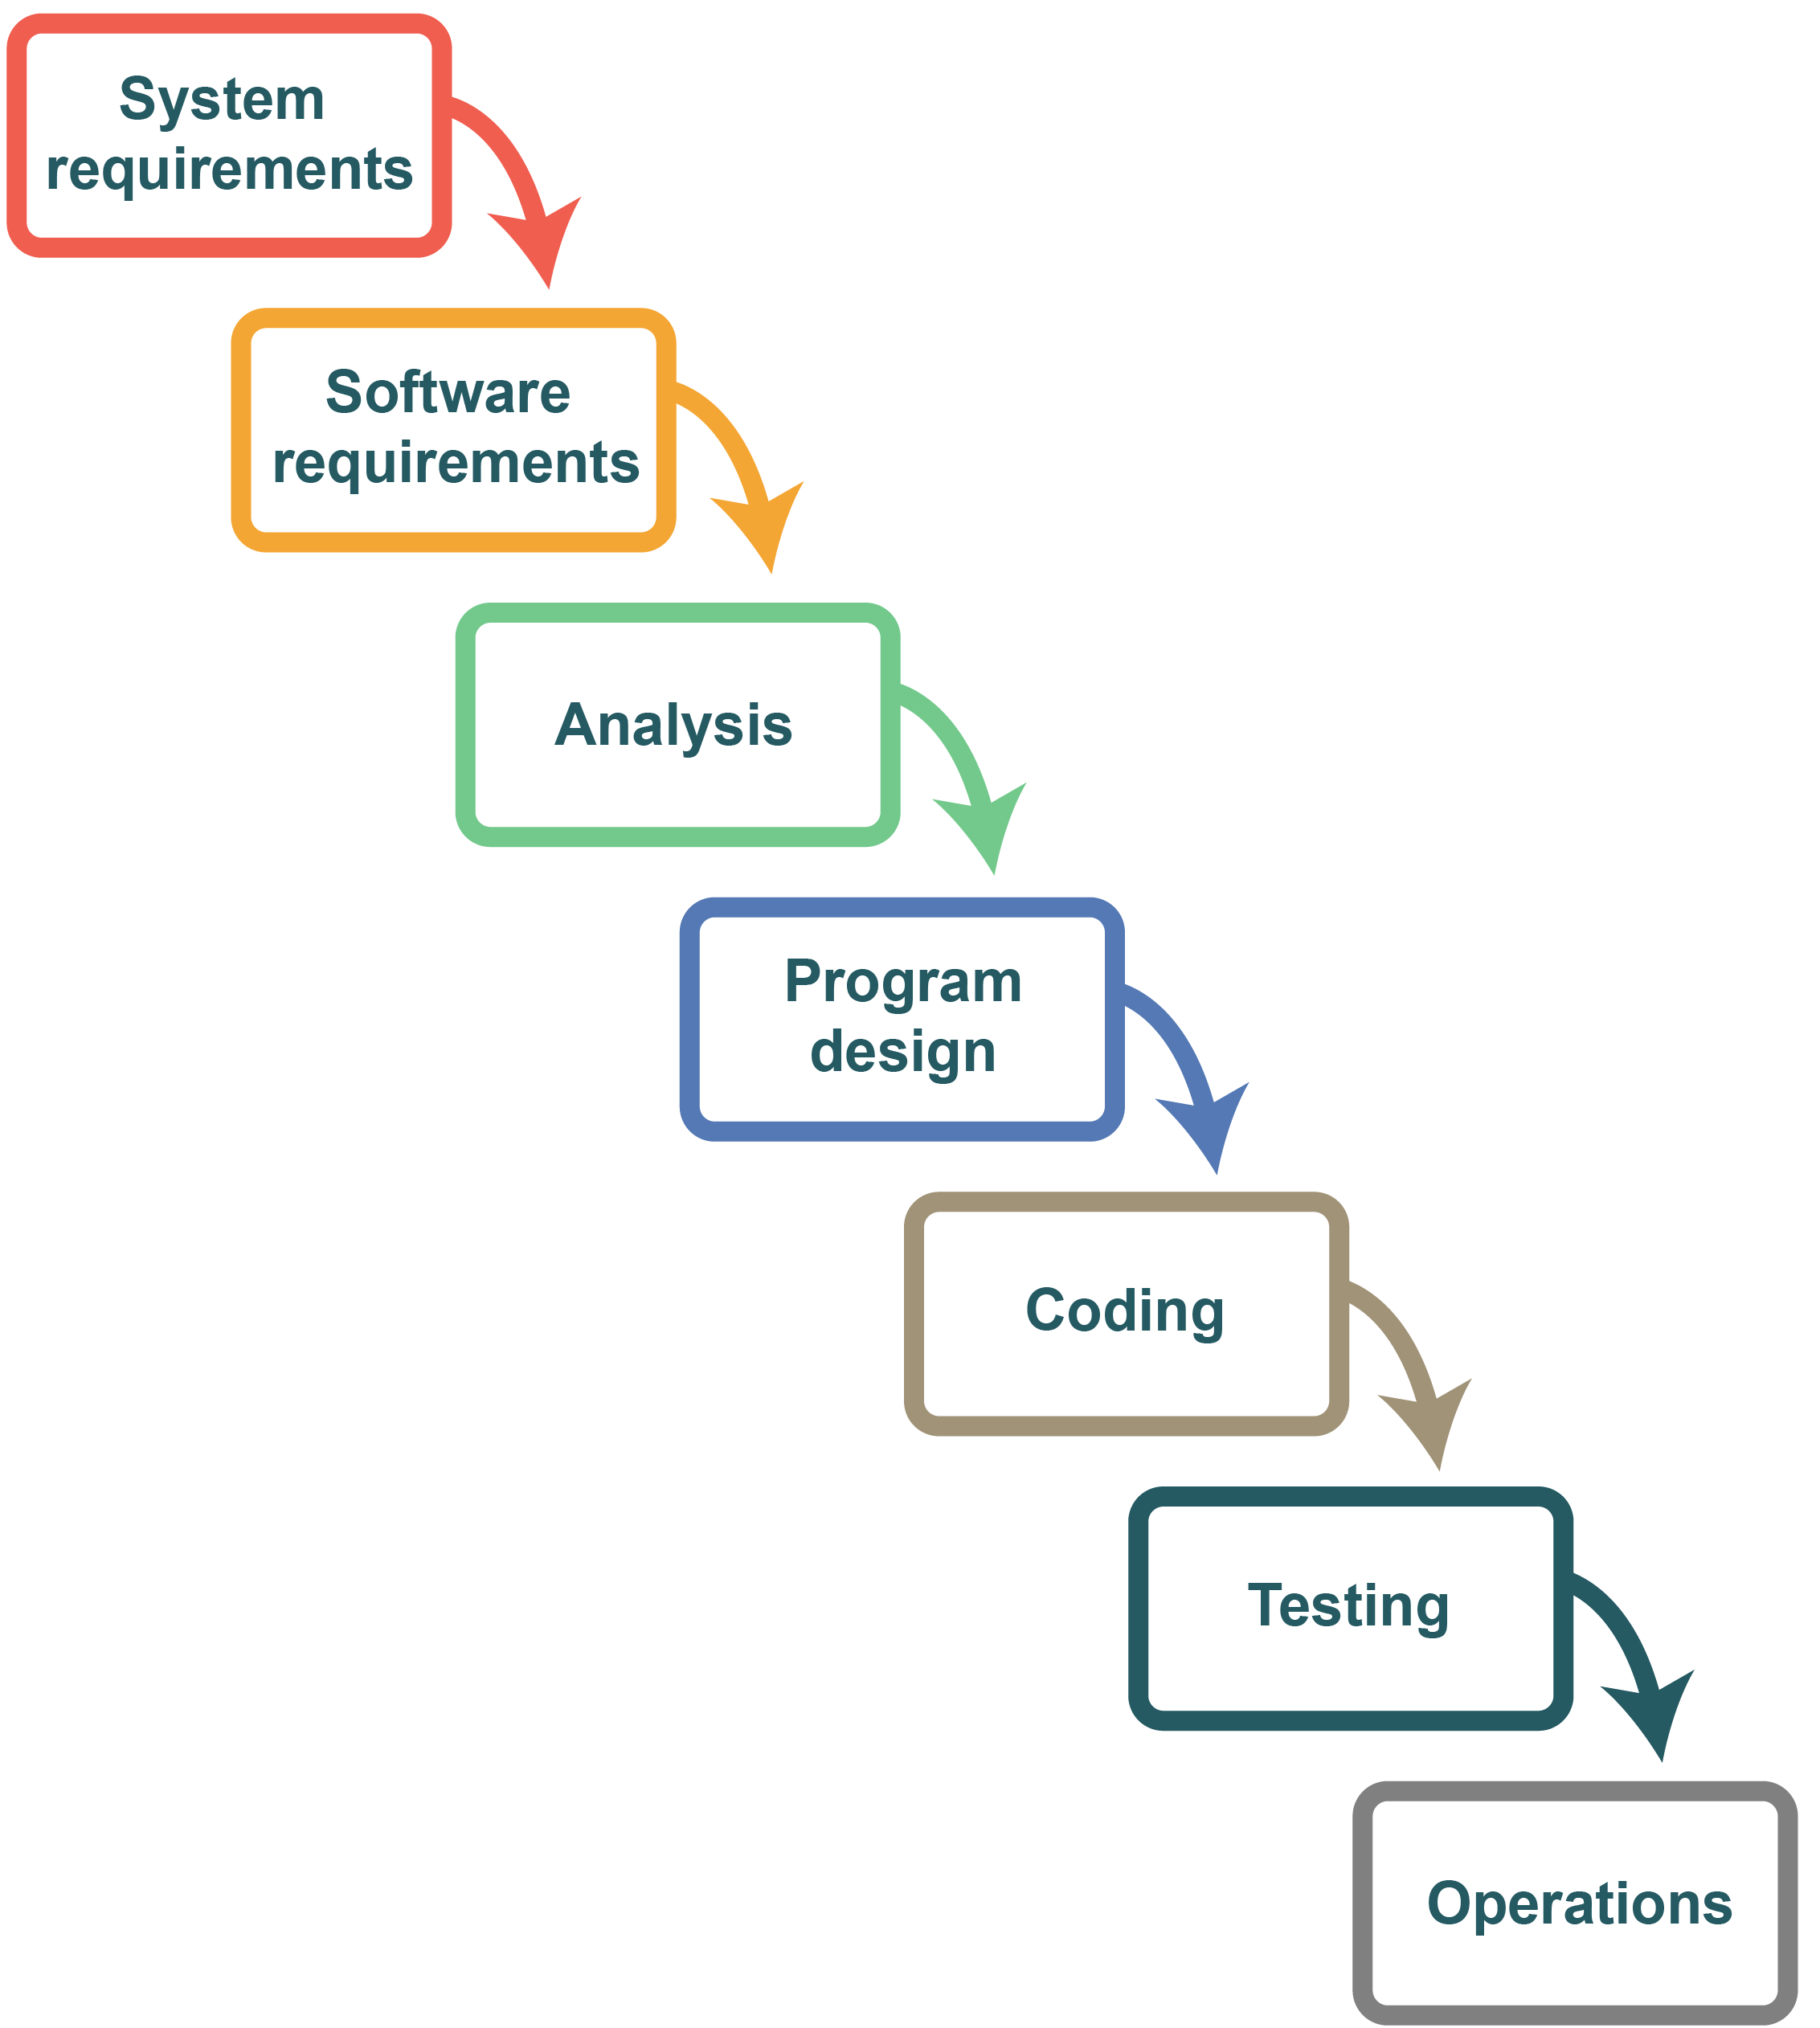
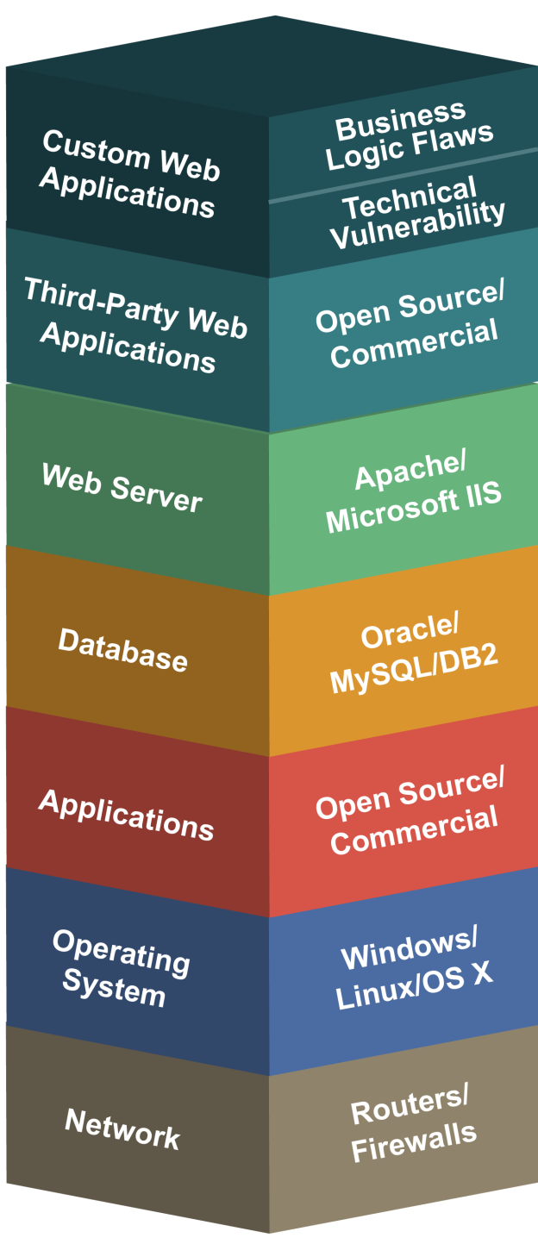
Teaching Digital
The
Lifecycle
The
Stack
Notes:
Pivoting… Education requires you to have a clear theory of sequence, what order you introduce topics in and their dependencies. This is called a “learning progression.” We use a couple different learning progressions for teaching digital: the Stack and the Lifecycle. In the stack (CS & IS approach), we learn abstractions, either bottom-up (CS) or top down (IS). In the lifecycle (SE), we learn the pipeline, but right now it’s heavily waterfall: requirements courses, architecture courses, implementation courses, testing/QA courses, all separate

Slide 27








A New Progression: Scaling
Enterprise
Team of teams
Team
Founder
THE
SCALING PROBLEM
What do we need? Why?
When do we need it?
How is it changing?
Notes:
This is the “emergence model” from my current book. I’ve used the idea, “from startup to enterprise” as it is effective with students. Everyone can relate to Larry and Sergei in the garage. Theoretically grounded in things like Dunbar’s Number – the individual, the family, the clan, the tribe, the nation. But it also applies as a sense-making tool for an individual in an existing enterprise, to orient you and help you understand the nature of the problems you face. Some of the problems we’re seeing in IT operating model discussions come from the state transitions that happen as we move our concern from bottom to top. In particular, the transition from team-centric to team of teams is very challenging and currently driving a lot of “religious” debate… such as “ITIL vs DevOps” or “product vs. project management.”

Slide 28

The 3 Dimensions of Digital Learning
Stack
Lifecycle
Scale
Notes:
This is an important conceptual point, you may need to think about. Whichever of these dimensions you choose as the main dimension for your learning progression, you have to collapse or subordinate the other two, because time, it’s a linear thing. If we teach using emergence, scale, as the main learning progression, we need full stack, full lifecycle from day 1: a DevOps walking skeleton! I call it Minimum Viable Pedagogy – it’s full stack & full lifecycle

Slide 29
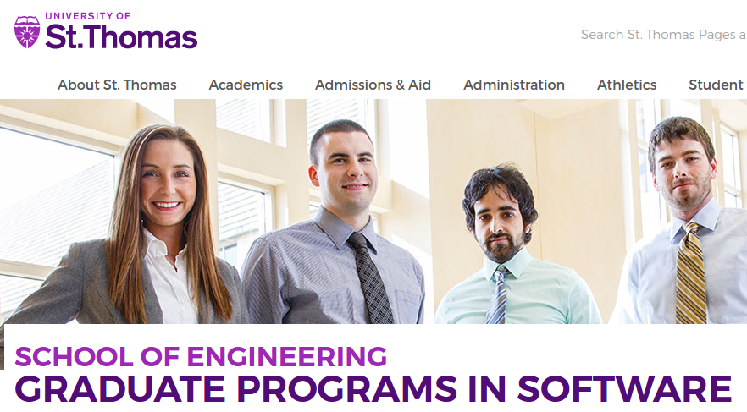
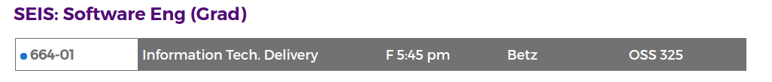
SEIS 664, “IT Delivery”
Notes:
This is my St. Thomas course. Essentially a broad IT management survey course. Follows scaling model as primary learning progression, and uses a flipped model, where lecture video viewed offline, in-class is all experiential – this is currently viewed as educational best practice, getting away from what they call “sage on a stage” - Lab approach is Full-stack, full lifecycle

Slide 30
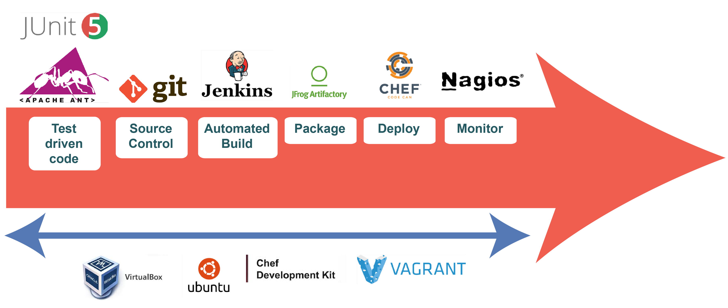
Calavera
Notes:
You can do things with virtualization that would have required millions of dollars in capital not too long ago.
This is just beginning to dawn on faculty… and is discussed in the report –The Calavera project is all defined “as code” on Github – a master Vagrantfile and a series of Chef recipes stands up an 8-node cluster simulating a minimum viable pipeline – (I call it minimum viable pedagogy) - We need a clearinghouse to curate these - They are Too valuable, Too labor intensive To not share

Slide 31
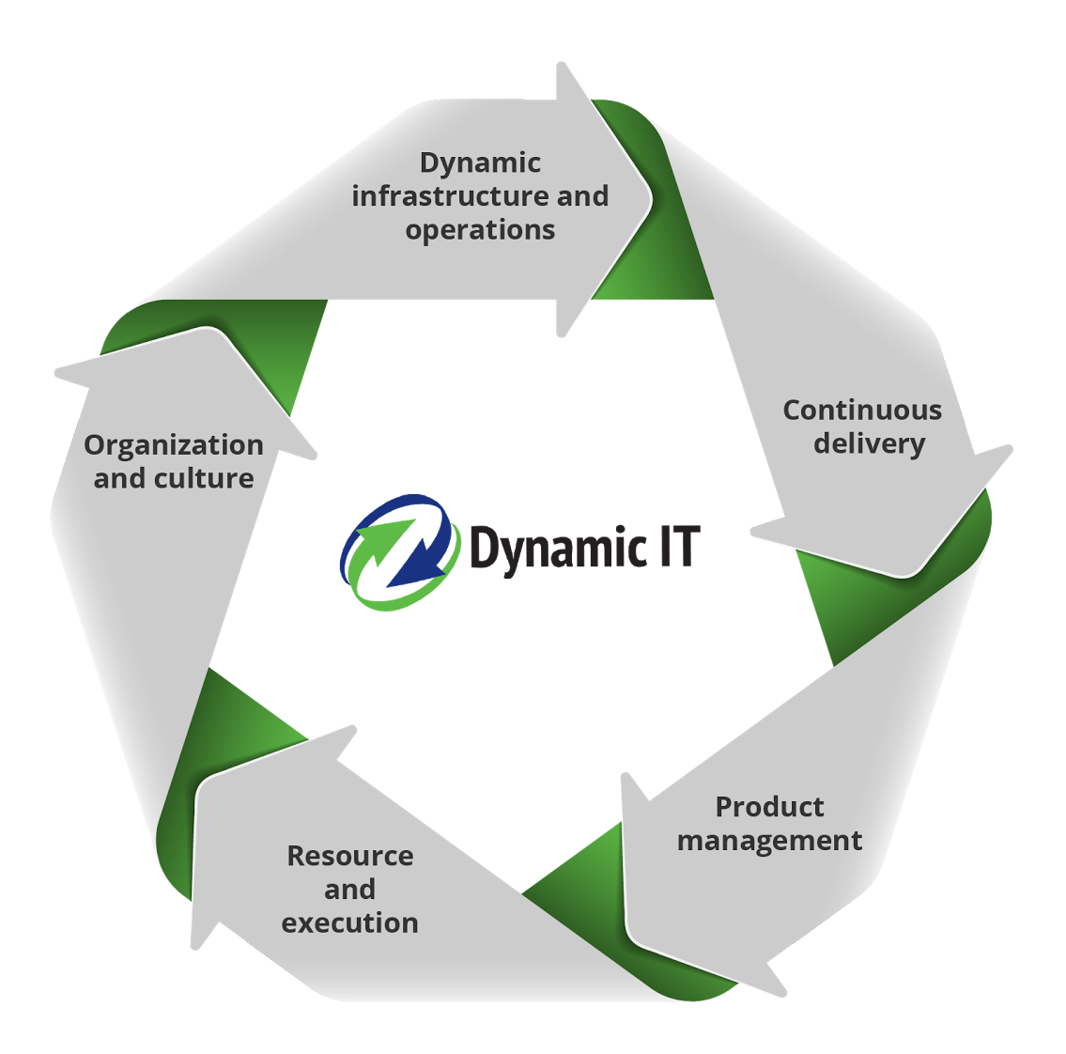
Going Forward
Advance-IT Minnesota sponsoring online portal at dynamicit.education
“As long as it benefits Minnesota, we are happy if it benefits everyone else!”
Report still considered preliminary at 1.0
Feedback being solicited for version 2.0, to be release Q2 2017 in time for fall course development
Notes:
Considering putting the guidance in some kind of online system (like a StackOverflow) for collaboration on specific competencies and learning objectives

Slide 32
What you can do
There are specific levers
State legislative processes/committee (e.g. Higher Education and Workforce)
State economic development agencies
State high tech lobbying associations
Program and institutional advisory boards
They are (or should be!) always interested in hearing from practitioners
If you don’t pull on these levers, someone else will

Slide 33
Resources
Dynamic IT report: http://dynamicit.education
Dynamic IT LinkedIn group: https://www.linkedin.com/groups/12018370
ACM/IEEE/AIS curricula guidance
http://www.acm.org/education/curricula-recommendations
Charles Betz resources:
Digital/Agile/DevOps management text
https://github.com/dm-academy/aitm
Calavera platform
https://github.com/dm-academy/Calavera
Course labs
https://github.com/dm-academy

Slide 34
Thank you!
For more information:
CharlesTBetz
char@dm-academy.com
www.lean4it.com

Slide 35

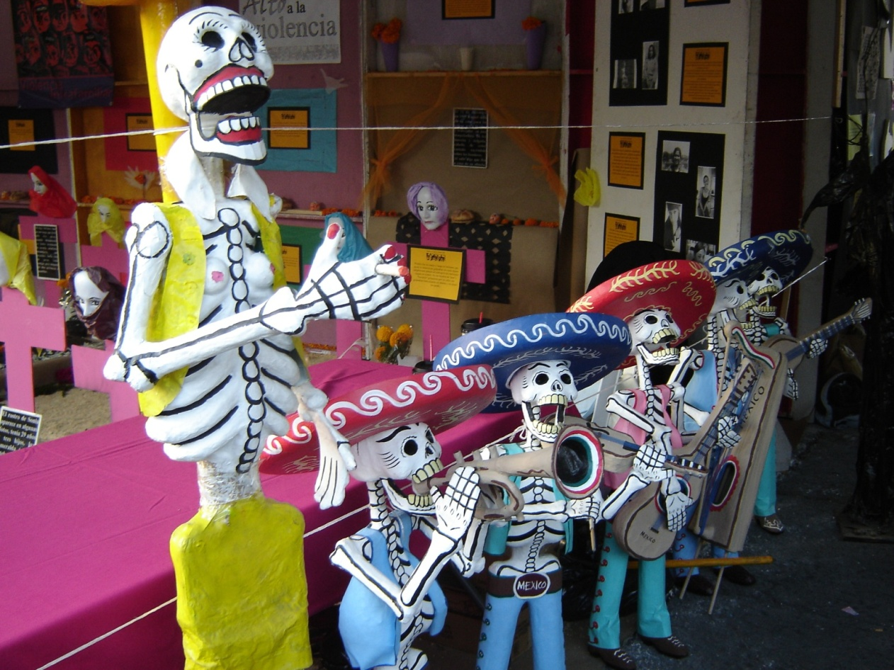

If you Google “Walking Skeleton”

